Slide 1
UNIT-II

Slide 2
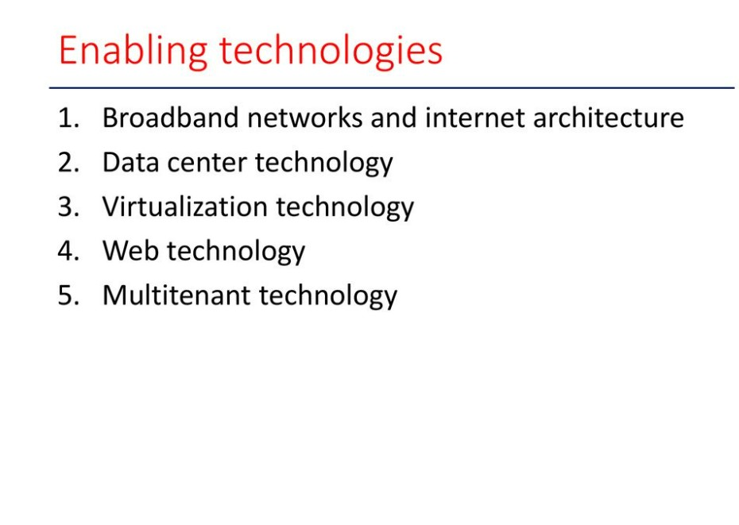

Slide 3
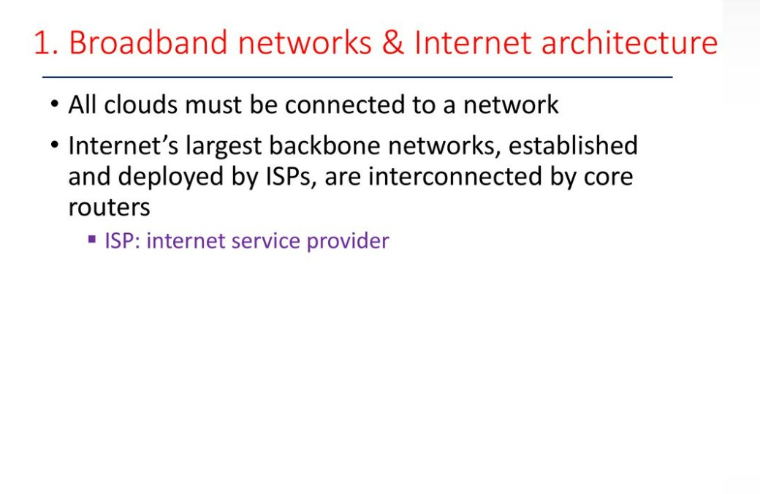

Slide 4
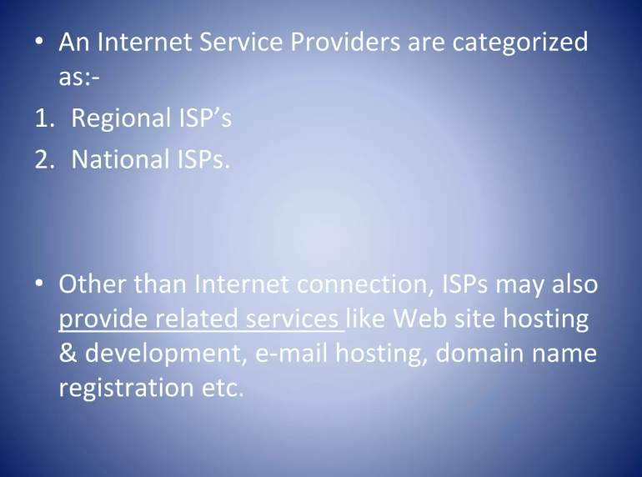

Slide 5
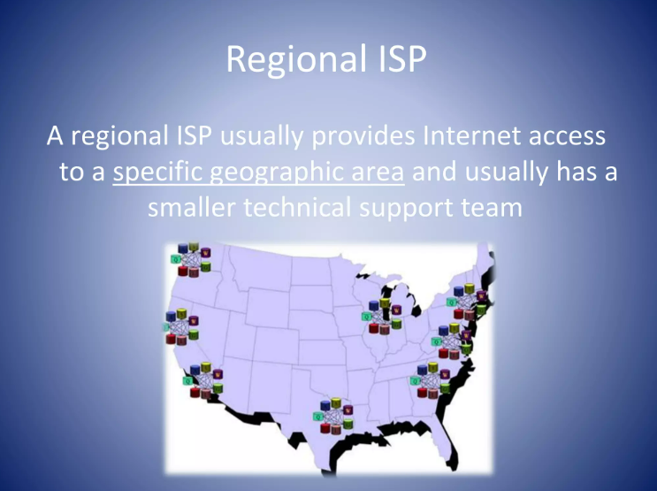

Slide 6
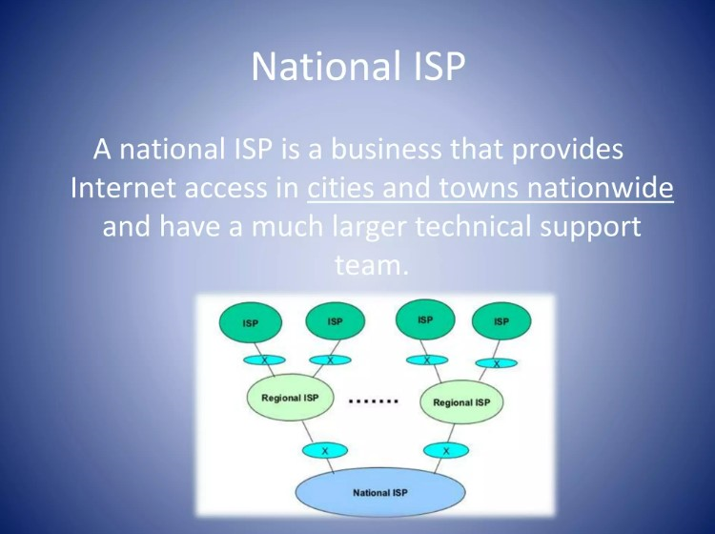

Slide 7
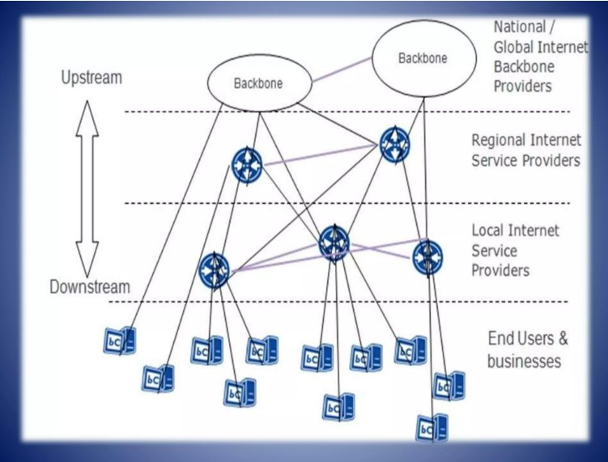

Slide 8
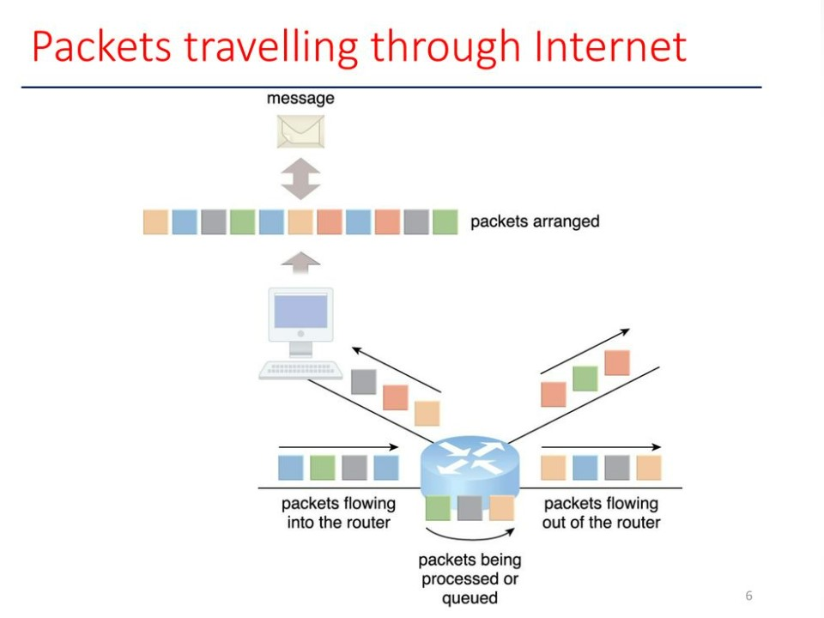

Slide 9
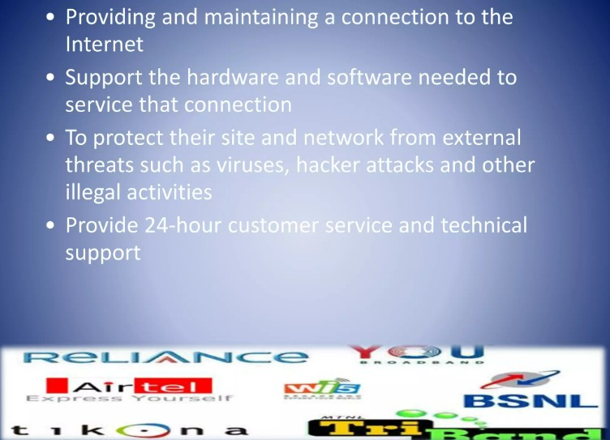

Slide 10
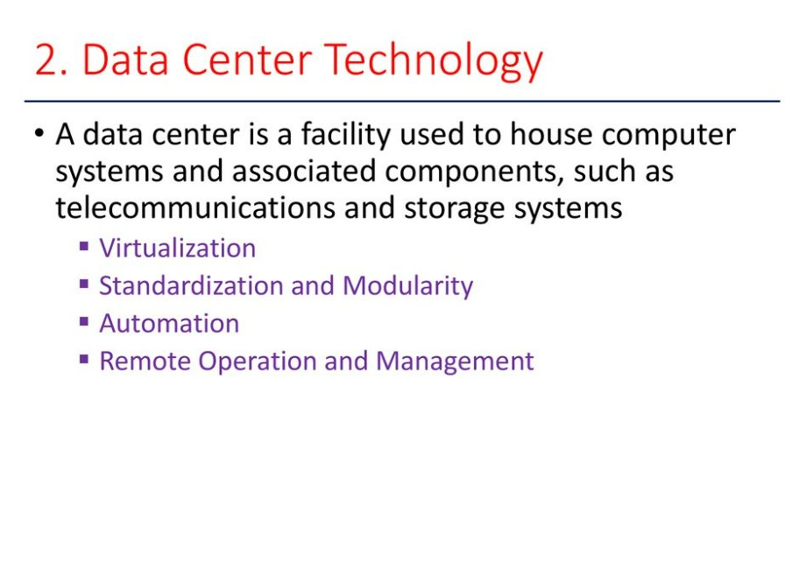

Slide 11
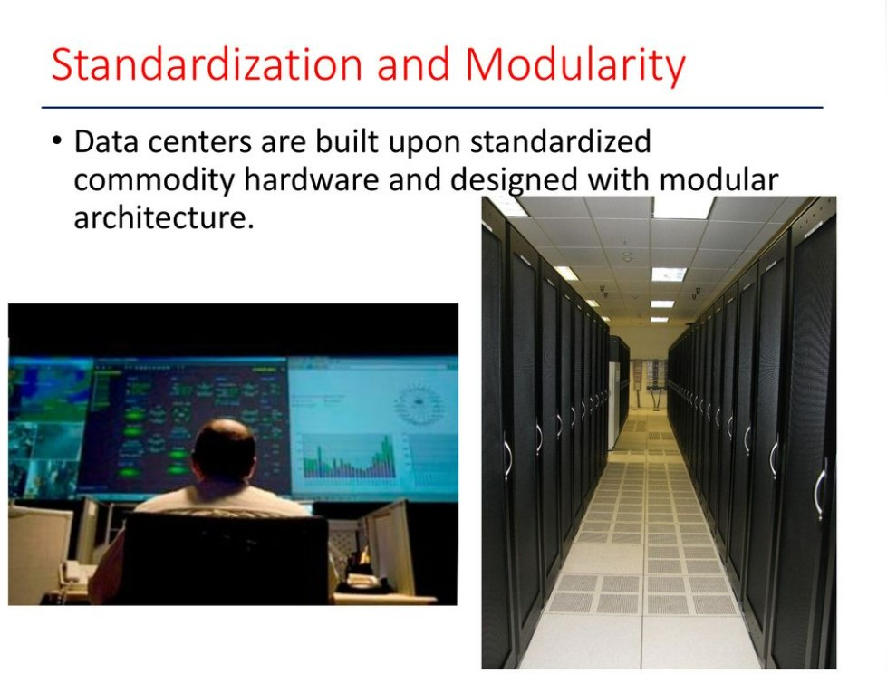

Slide 12
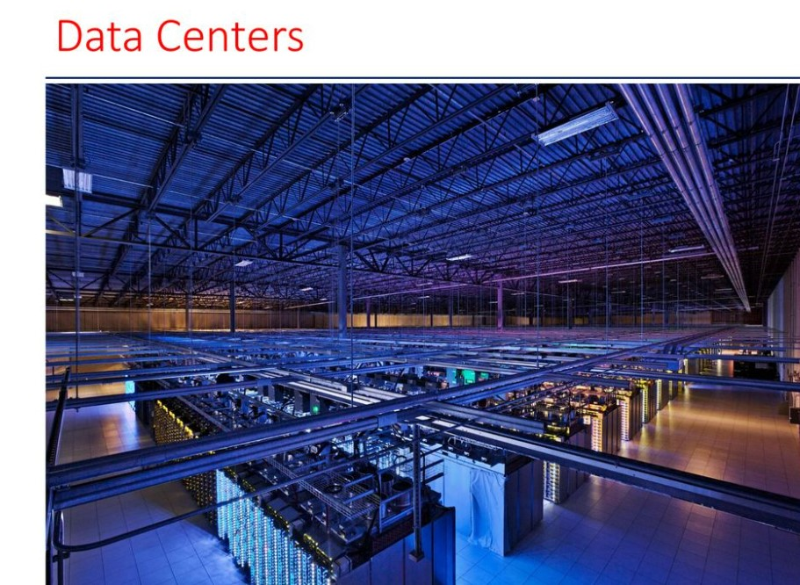

Slide 13
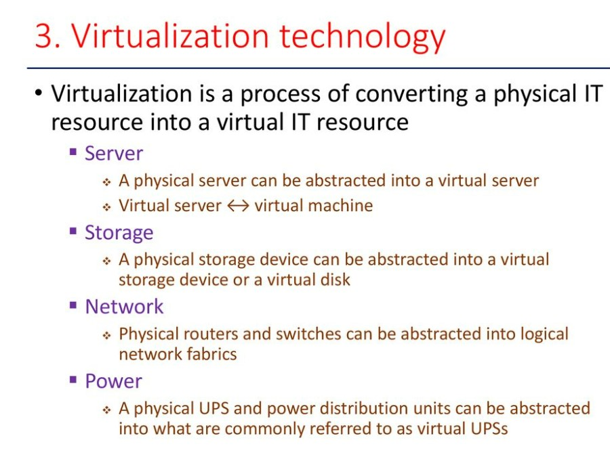

Slide 14
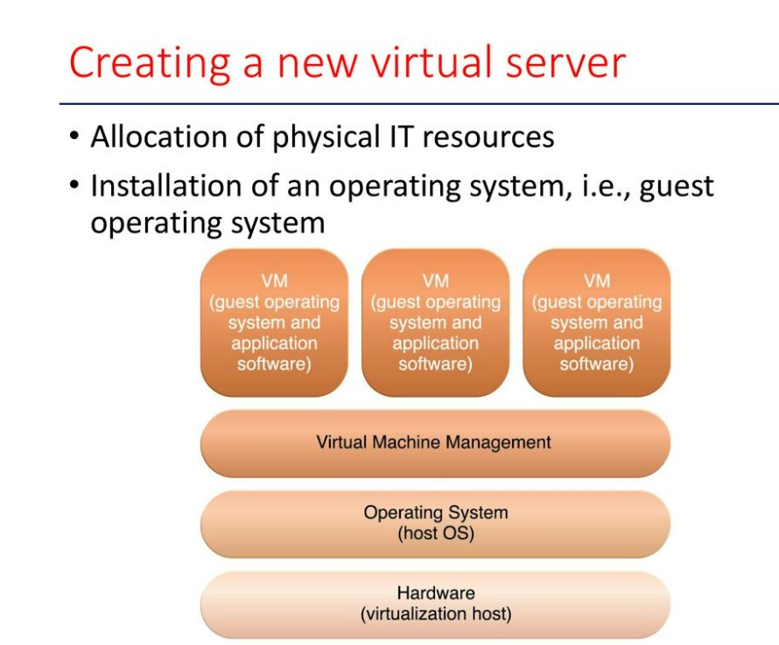

Slide 15
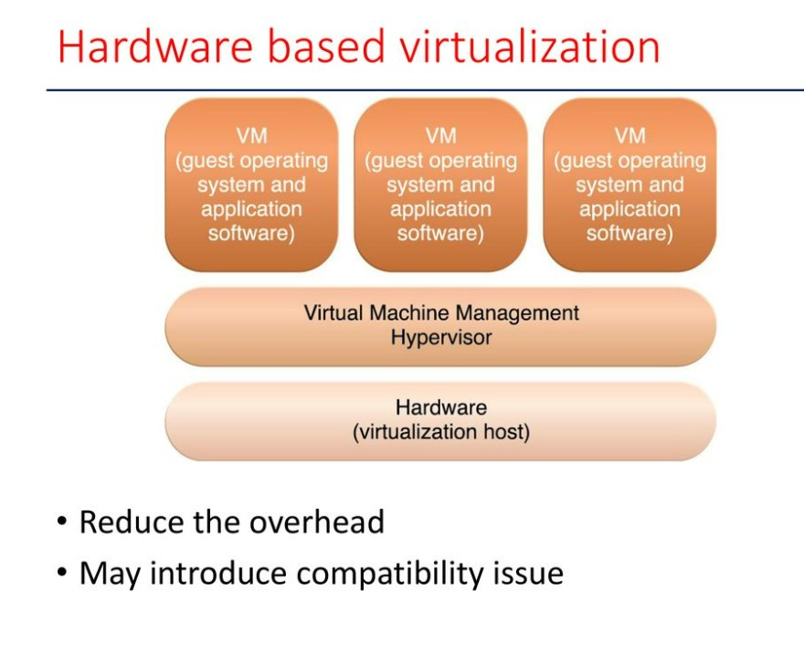

Slide 16
Types of Virtualization
Apart from hardware virtualization, other types of virtualization include:
Application Virtualization
Data Virtualization
Desktop Virtualization
Network Virtualization
Server Virtualization
Storage Virtualization

Slide 17
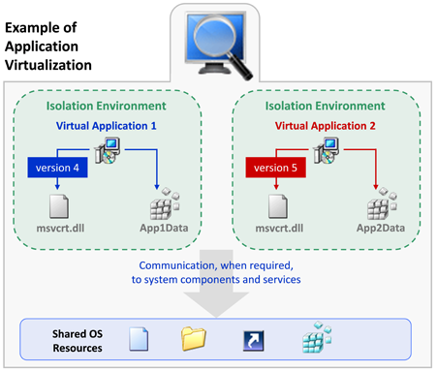
Application virtualization
The process of installing an application on a central server (single computer system) that can virtually be operated on multiple systems is known as application virtualization. For end users, the virtualized application works exactly like a native application installed on a physical machine. With application virtualization, it’s easier for organizations to update, maintain, and fix applications centrally. Admins can control and modify access permissions to the application without logging in to the user’s desktop.

Slide 18
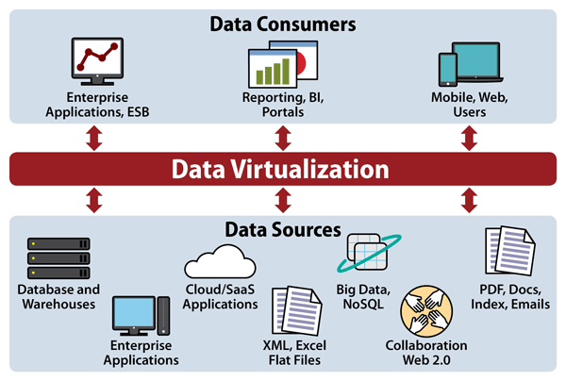
Data Virtualization

Slide 19
Data virtualization is a logical data layer that integrates all enterprise data siloed (isolated from others.) across the disparate systems, manages the unified data for centralized security and governance, and delivers it to business users in real time..

Slide 20
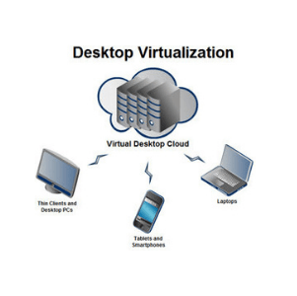
Desktop virtualization

Slide 21
Desktop virtualization is a method of simulating a user workstation so it can be accessed from a remotely connected device. By abstracting the user desktop in this way, organizations can allow users to work from virtually anywhere with a network connecting, using any desktop laptop, tablet, or smartphone to access enterprise resources without regard to the device or operating system employed by the remote user.
Remote desktop virtualization is also a key component of digital workspaces Virtual desktop workloads run on desktop virtualization servers which typically execute on virtual machines (VMs) either at on-premises data centers or in the public cloud.
Since the user devices is basically a display, keyboard, and mouse, a lost or stolen device presents a reduced risk to the organization. All user data and programs exist in the desktop virtualization server, not on client devices.

Slide 22
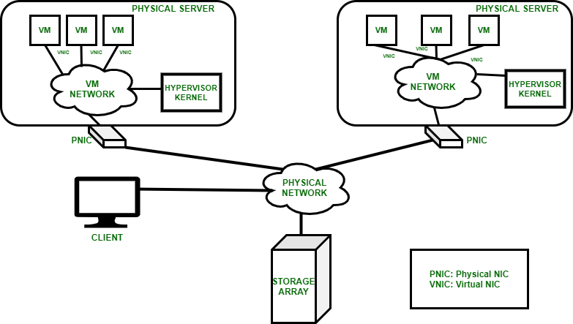
Network virtualization

Slide 23
Network virtualization helps manage and monitor the entire computer network as a single administrative entity. Admins can keep a track of various elements of network infrastructure such as routers and switches from a single software-based administrator’s console. Network virtualization helps network optimization for data transfer rates, flexibility, reliability, security, and scalability. It improves the overall network’s productivity and efficiency. It becomes easier for administrators to allocate and distribute resources conveniently and ensure high and stable network performance.

Slide 24
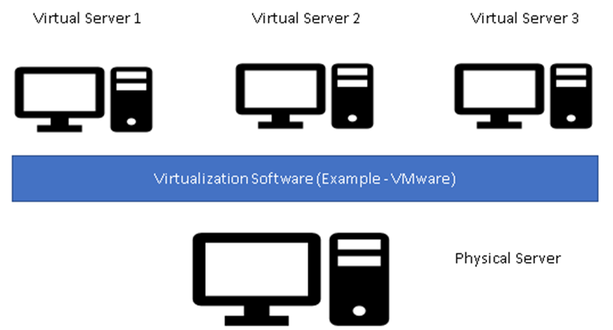
Server virtualization

Slide 25
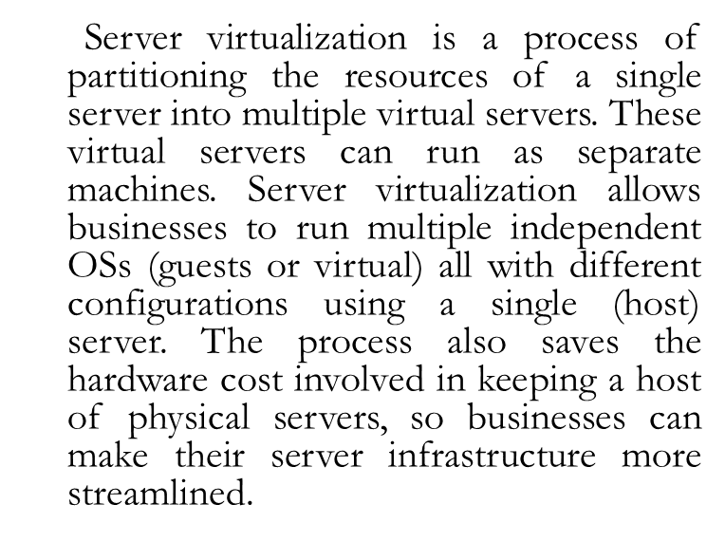

Slide 26
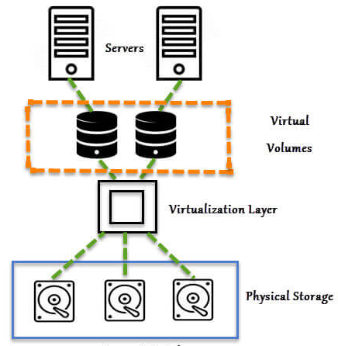
Storage virtualization

Slide 27
Storage virtualization performs resource abstraction in a way that the multiple physical storage arrays are virtualized as a single storage pool with direct and independent access.
The storage virtualization software aggregates and manages storage in various storage arrays and serves it to applications whenever needed.
The centralized virtual storage increases flexibility and availability of resources needed. This data virtualization and centralization is easily manageable from a central console. It allows users to manage and access multiple arrays as a single storage unit.

Slide 28
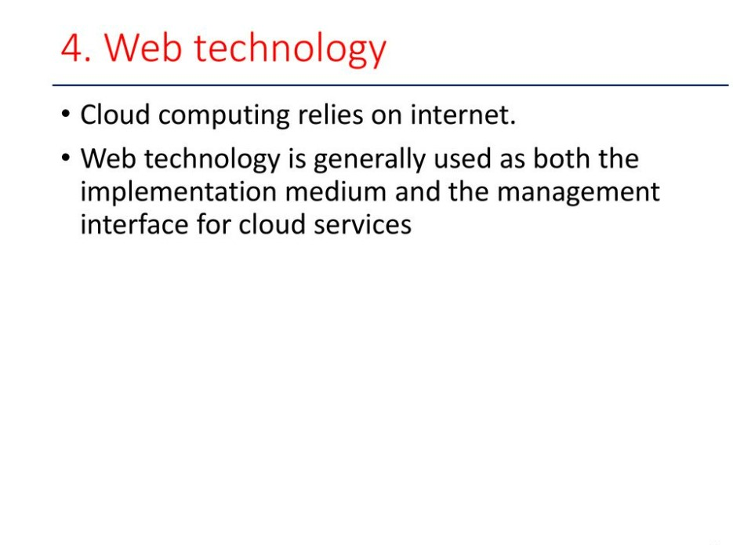

Slide 29
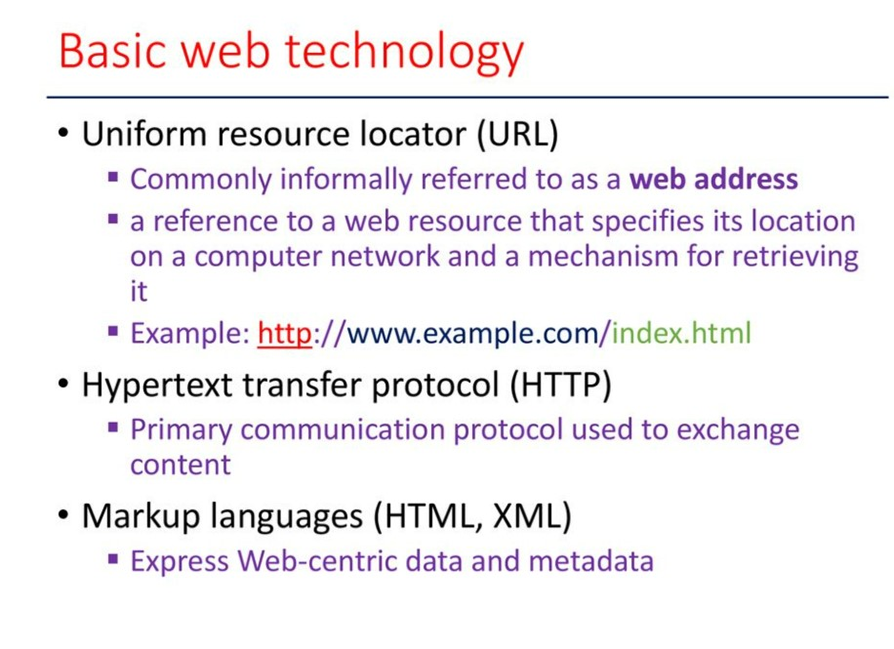

Slide 30
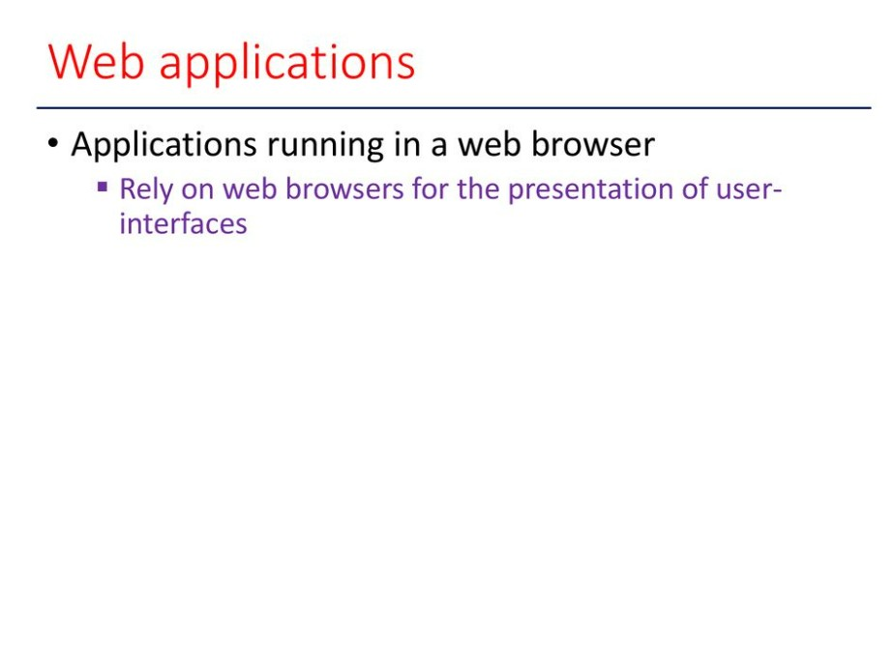

Slide 31
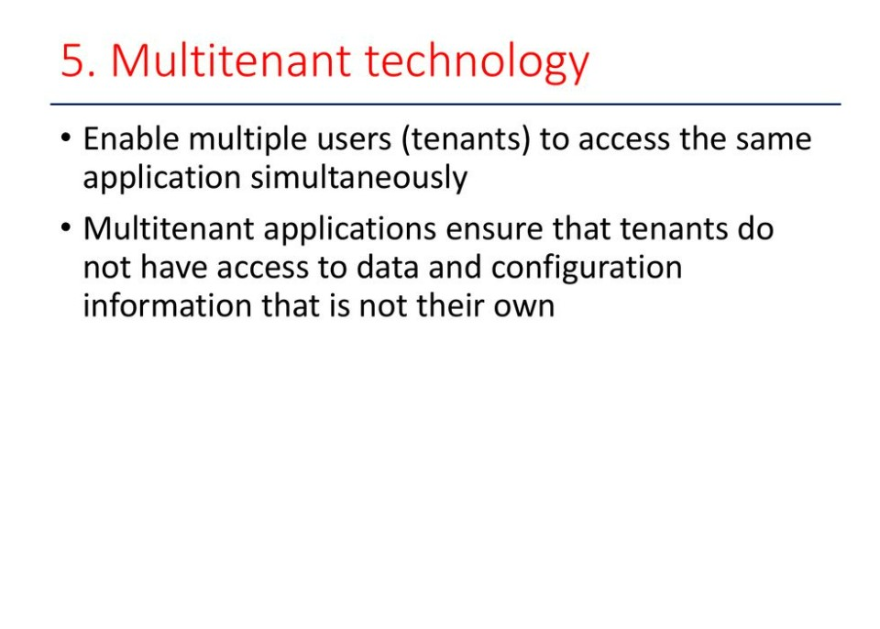

Slide 32
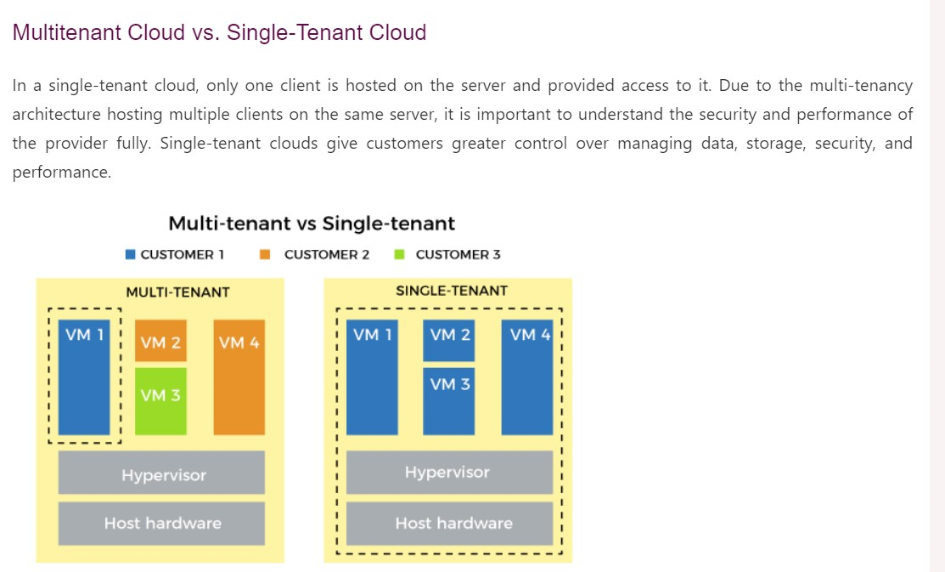

Slide 33
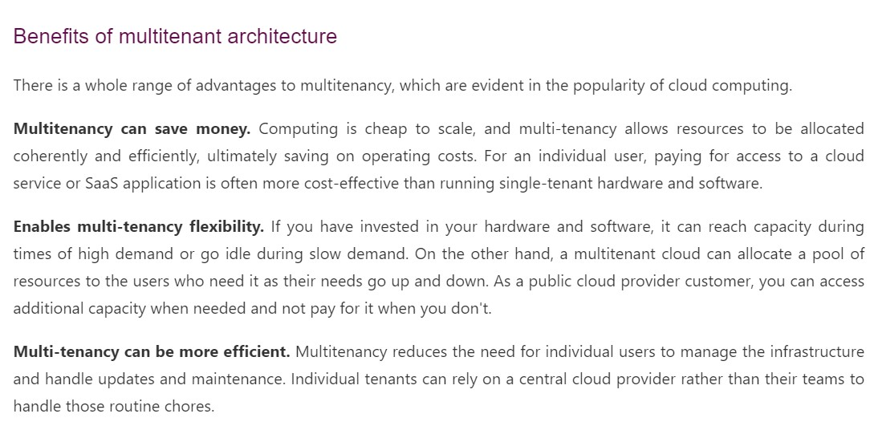

Slide 34
